Slide 1
GenAI and financial data alert systems
GenAI Insight Overlays
Client: Alvarez & Marsal
David Velasquez david.velasquez.24@ucl.ac.uk

Slide 2
Process Summary
Requirement Analysis
(Personas)
High Level Design
Implementation Stage 1
Single Task Architecture
Implementation Stage 2
Workflow Driven Architecture

Slide 3
Requirements Analysis Summary
Target personas not particularly tech savvy, and used to the intuitive interface of a dashboard
Setup must be simple
Key output they need is knowing where to look in detail for their next steps, so a high-level report can be good enough in early iterations.
Different type of users need not just different KPIs but different detail levels
Likely need to create different prompt sets for each
Design must be Modular and Extensible

Slide 4
Requirements Analysis Summary (cont’d)
Report Parts | Sales Manager | CFO
Retrieve high-level data (e.g., Sales trend, filtered, over time)
Retrieve detailed data (e.g., Sales by product for the last period)
Simple Sales forecasts based on current trends
Retrieve changes in detailed data that explain current trends
Recommend potential actions to remedy negative trends
Sales forecasts based on the remedy action
Customized email body based on report
Data Sources
CSV File Retrieval Agent
Azure Database Retrieval Agent | Not Used
File Information Retrieval Agent (e.g., company reports)
Web Search Agent
Frontend
Frontend to configure a single run internal for all requests
Frontend for defining report scope (e.g., sales region)
Frontend to configure emails to receive report
Not relevant with anonymized data

Slide 5
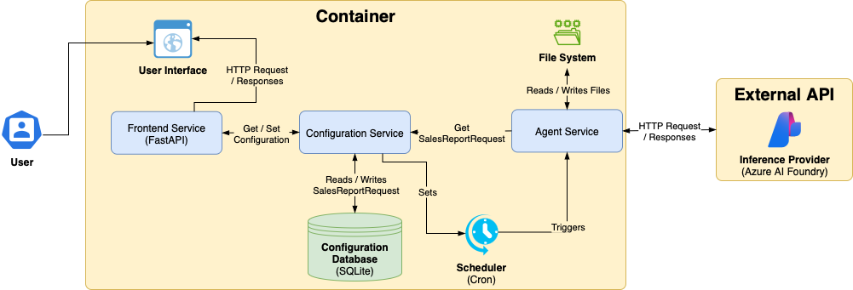
High-Level Design

Slide 6
Implementation Technical Complexity: Agent needs to “think” like an analyst
Loosely defined task
Multiple potential paths, depth of research depends on previous findings
Context, nuance and causality
Human analysts keep a lot of context in their head and make causal inferences
Lack of training data for models
Every company is different, and they don’t share their internal analysis publicly!

Slide 7
Implementation Methodology: Two stage experiment (1 / 2)
Stage 1: Single orchestration framework for the entire task
Key findings:
Easier to set up – single prompt for the main task + system prompt per agent
Can follow general outlines quite well, but not the nuance / details
Context grows too quickly, “blowing up” the context for each agent

Slide 8
Implementation Methodology: Two stage experiment (2 / 2)
Stage 2: Detailed workflow
Key findings:
Breaking task in smaller, better-defined steps improves LLM reliability
Context management is key – e.g., allowing context to grow within deep tasks but exposing only outputs to the rest of the flow
Iterative agents tend to go into “rabbit-holes” – important to build flows that can unstuck themselves, but also define forceful exit points when there isn’t a good measure of done
Note: My final process is quite in with LangChain’s guide for building agents, and their new “Deep Agents”

Slide 9
Implementation Methodology: Final Detailed Workflow
Direct call to LLM
Single-agent
Multi-agent Flow

Slide 10
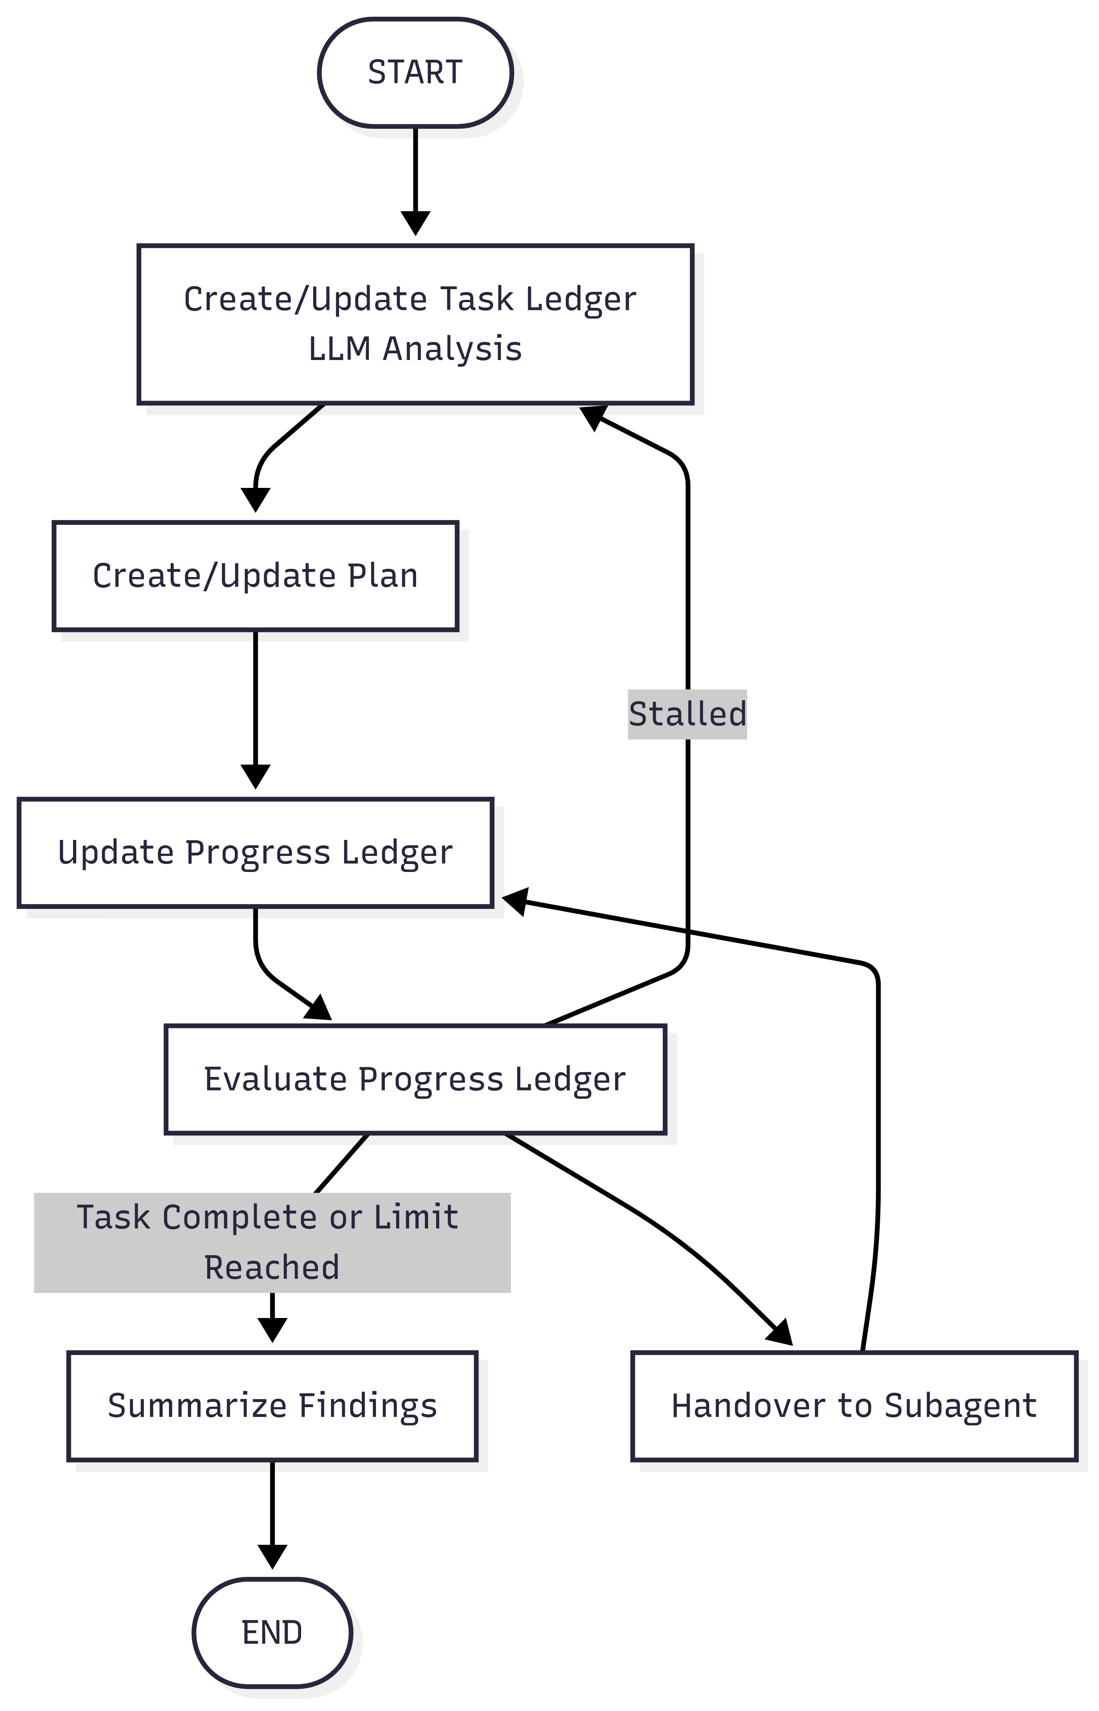
Implementation Highlight: Research Graph (Based on Magentic One - Microsoft Research AI Frontiers, 2024)

Slide 11
Future Work: Production Readiness
Improve Evaluation framework:
Automatic evaluation of outputs would allow for faster iterations
Evaluating intermediate steps when executing the entire task could highlight where the agent is struggling most
Improve Retry logic:
Move from workflow-level retry to step-level, avoiding work loss

Slide 12
Thank You!
GitHub: https://github.com/davidve0206/ai-analyst/

